Slide 1
Mammogram Dataset Analysis
Praveen Bhargav
Christo Thomas
Farid Ahmed
Sai Sandeep
Pavithran
Surya Y

Slide 2
Introduction
Breast cancer (BC) is one of the most common cancers among women worldwide, representing the majority of new cancer cases and cancer-related deaths according to global statistics, making it a significant public health problem in today’s society.
Mammography: The most important screening test for breast cancer is the mammogram. A mammogram is an X-ray of the breast.
The early diagnosis of BC can improve the chance of survival significantly, as it can promote timely clinical treatment to patients.
Accurate classification of benign tumors can prevent patients undergoing unnecessary treatments.

Slide 3
Objectives
This analysis aims to observe which features are most helpful in predicting malignant or benign cancer and to see general trends that may aid us in model.
The goal is to classify whether the breast cancer is benign (0) or malignant (1). To achieve this we have used machine learning classification methods to fit a function that can predict the discrete class of new input.

Slide 4
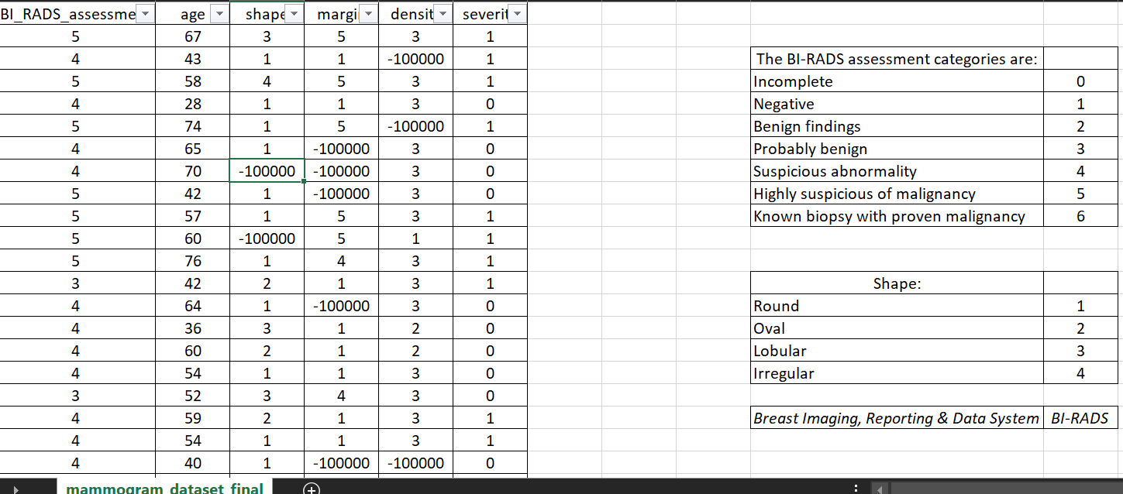
Mammogram Dataset

Slide 5
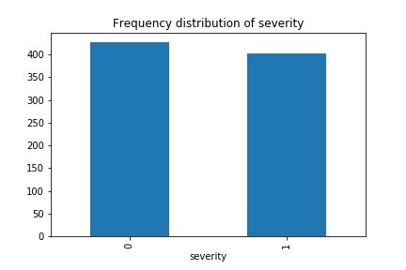
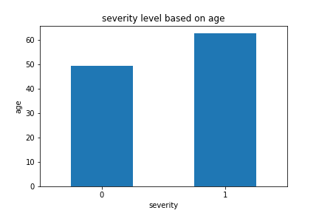
Exploratory Data Analysis
Frequency distribution of Severity
Severity level based on age

Slide 6
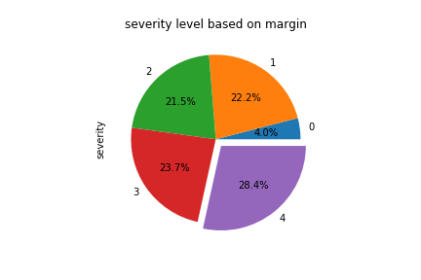
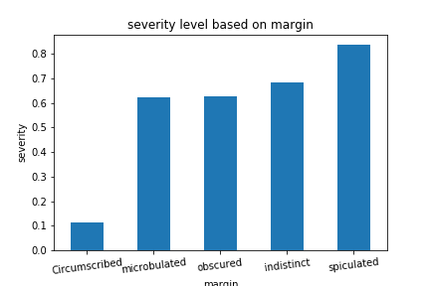
Exploratory Data Analysis
Severity level based on margin

Slide 7
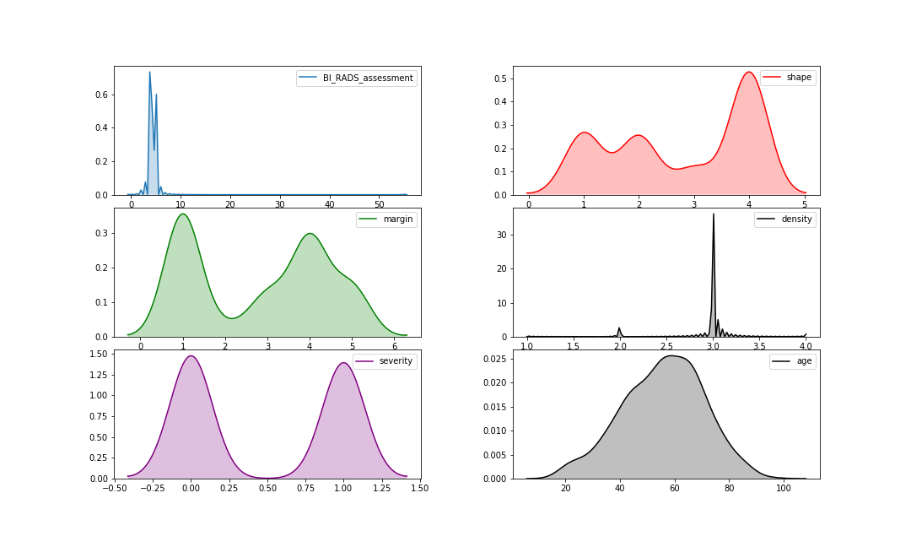
Exploratory Data Analysis
Skewness of Features:

Slide 8
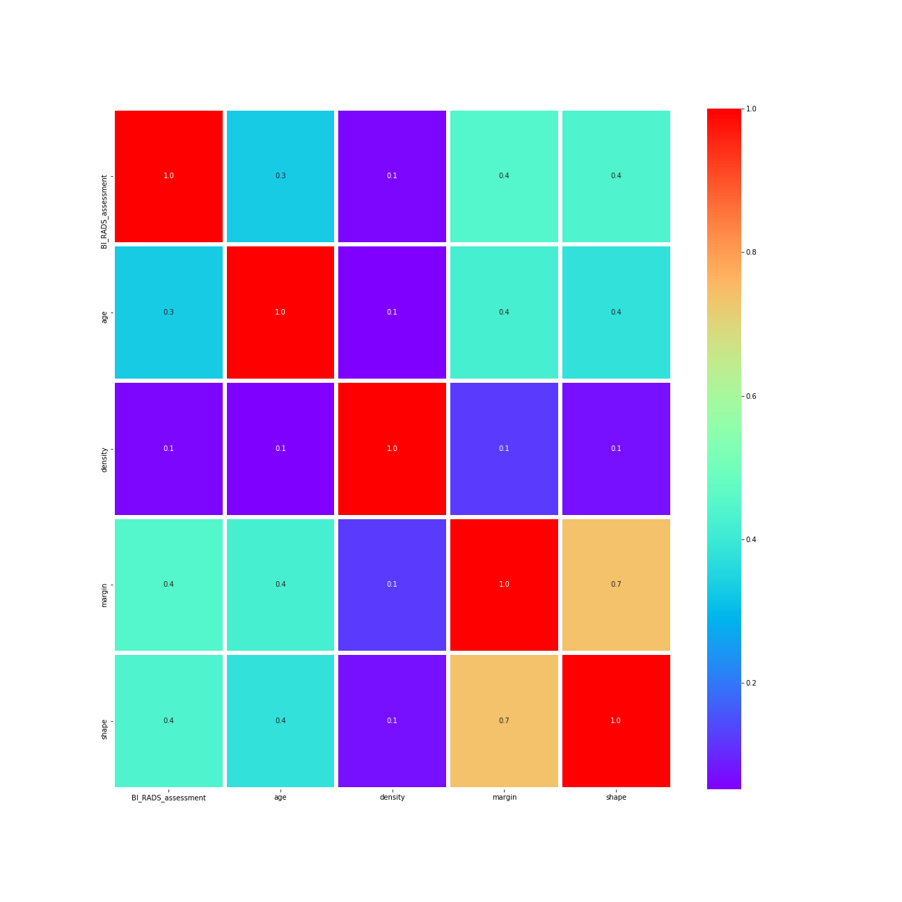
Correlation between Features

Slide 9
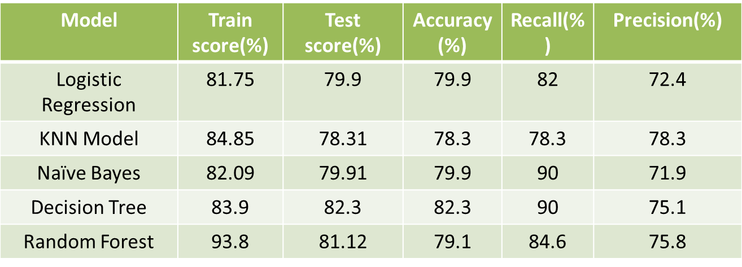
Actual accuracies of each model

Slide 10
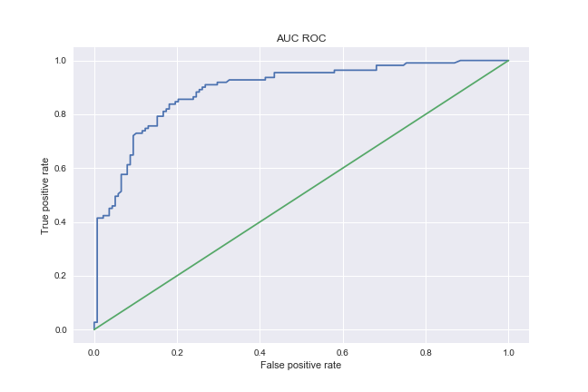
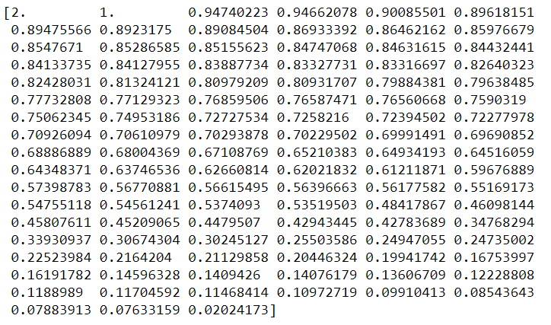
ROC Curve

Slide 11
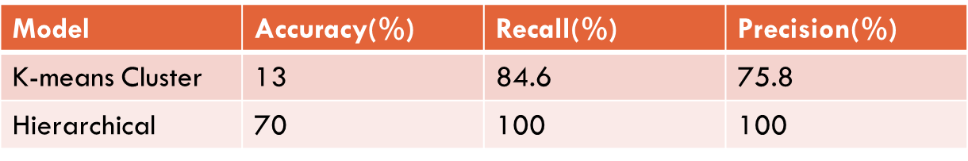
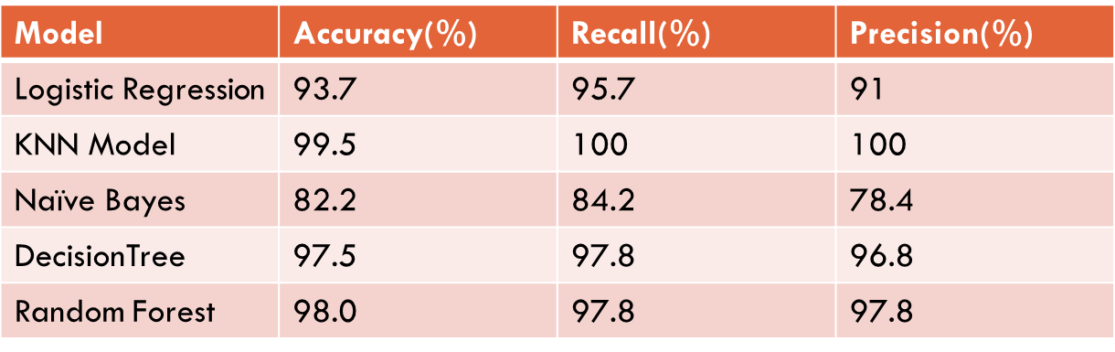
After converting SL TO USL
After concatenating the new label with the main data the Accuracy, Recall and Precision will look like:

Slide 12
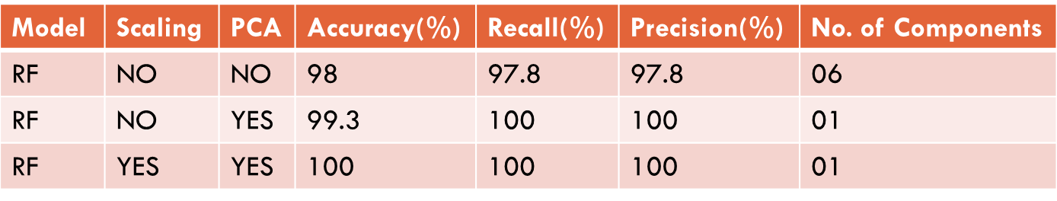
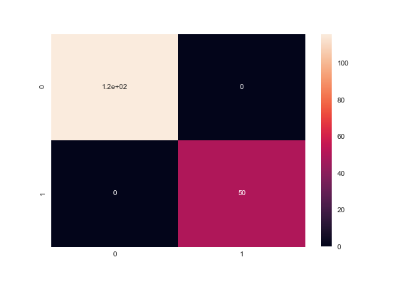
After applying PCA(Principle component analysis)
Confusion Matrix

Slide 13
Inference and Solution
So finally we have built our classification model and we can see that Random Forest Classification algorithm with Principle component analysis gives the best results for our dataset.
We can suggest that Mammography is the best study to identify the severity in the early stages of Breast cancer.

